Slide 1
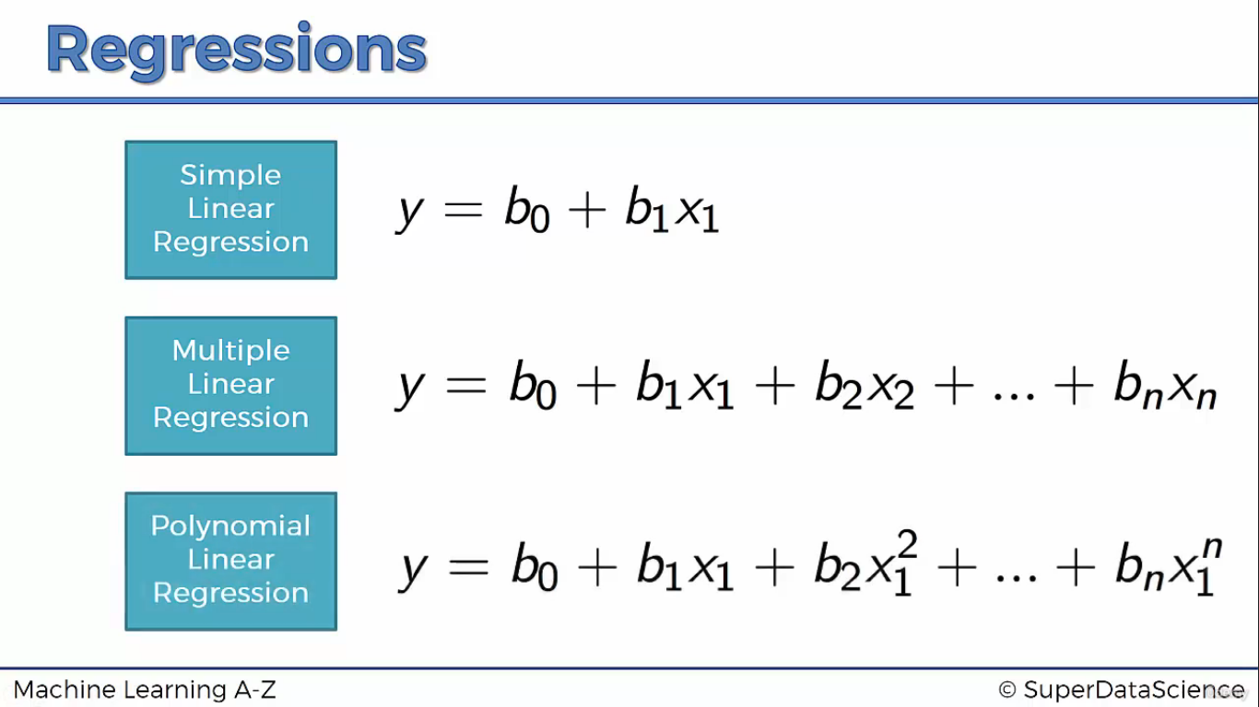

Slide 2
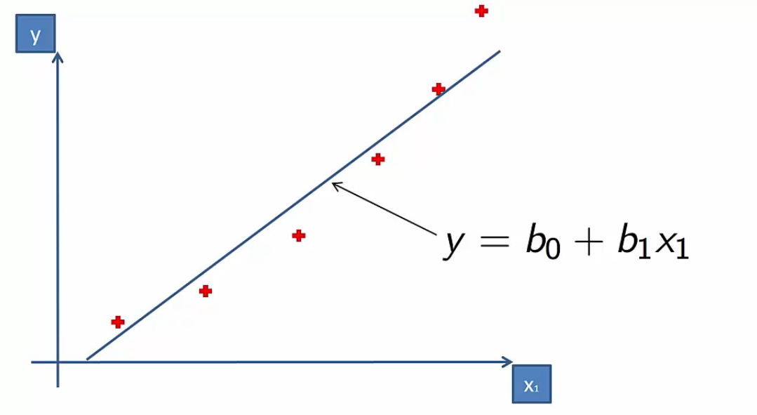
Simple Linear Regression is not Suitable in this case

Slide 3
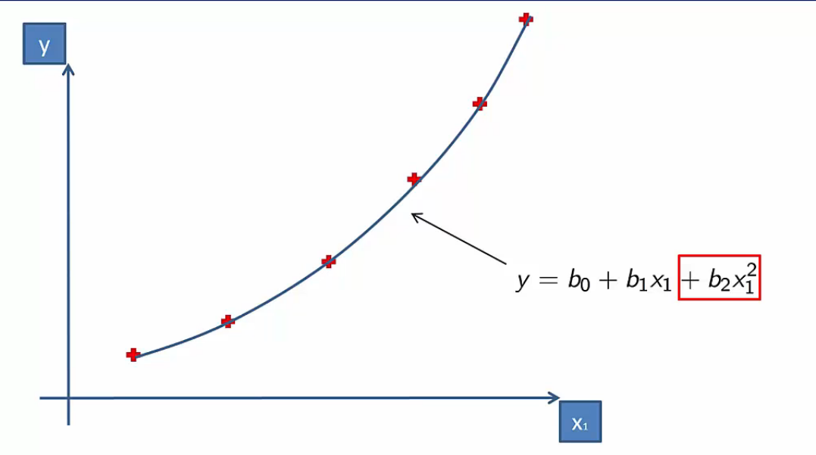
Polynomial Regression

Slide 4
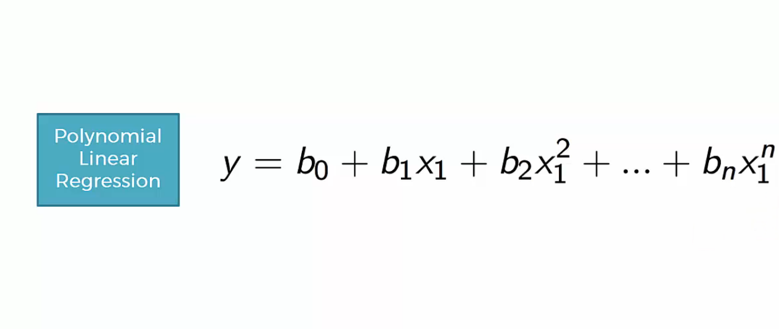
Polynomial Regression of degree n

Slide 5
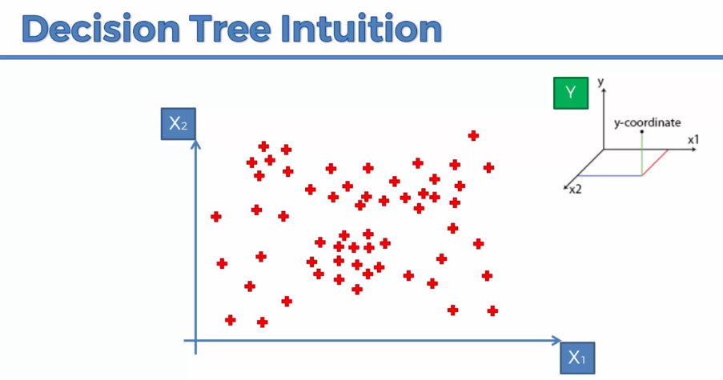

Slide 6
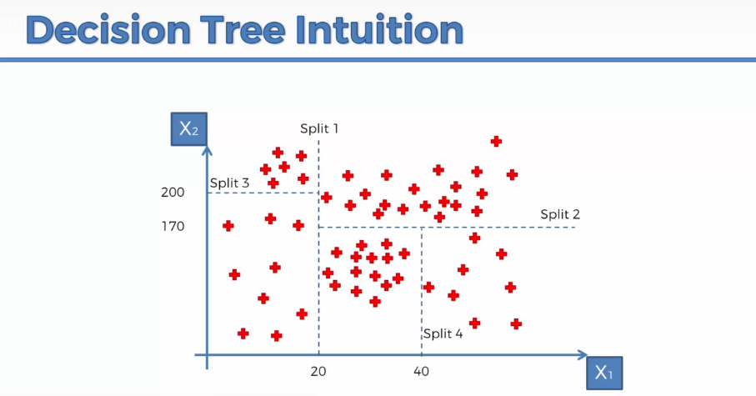

Slide 7
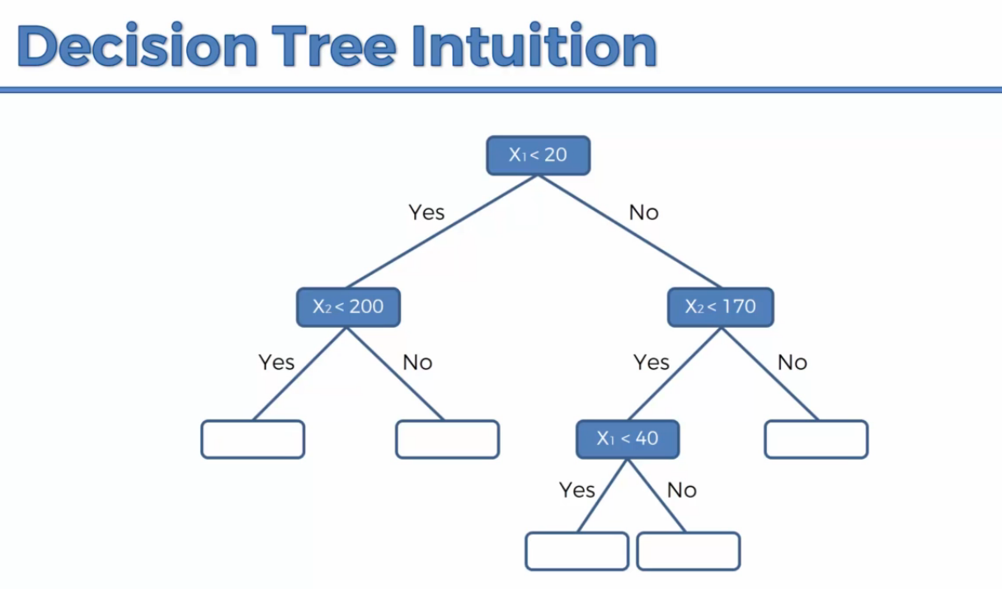

Slide 8
Support Vector Machine
By Vandana Kate

Slide 9
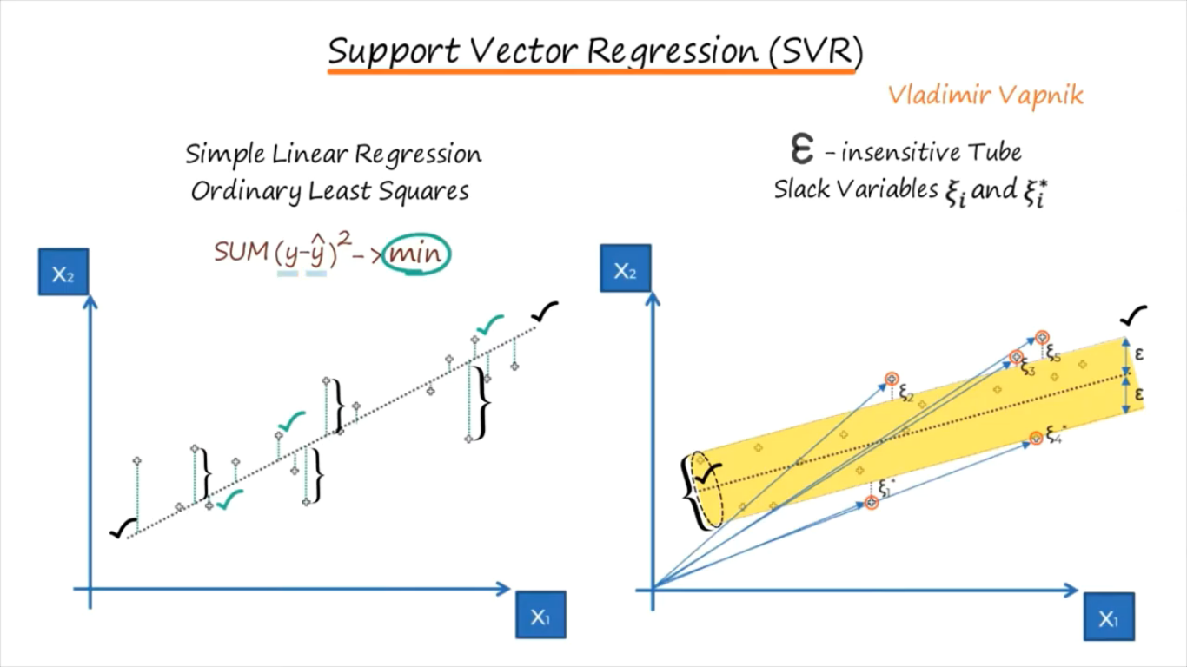

Slide 10
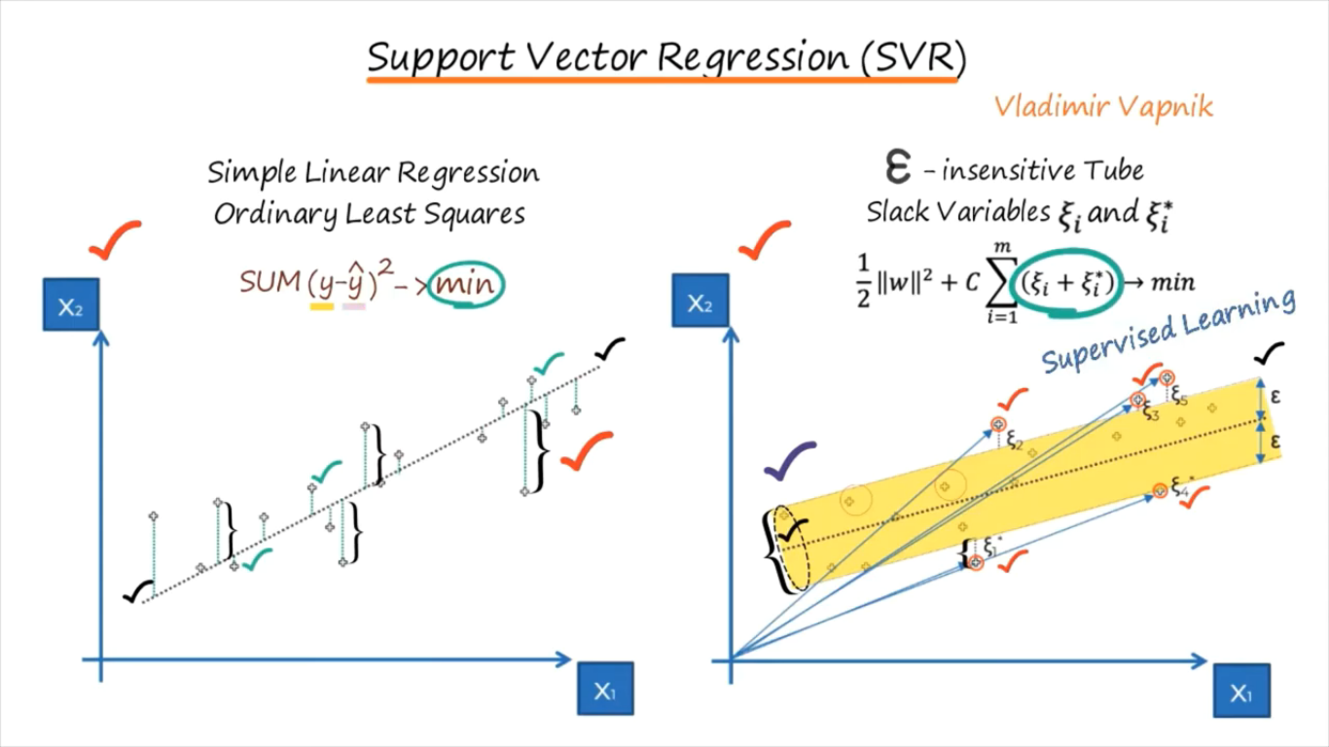

Slide 11
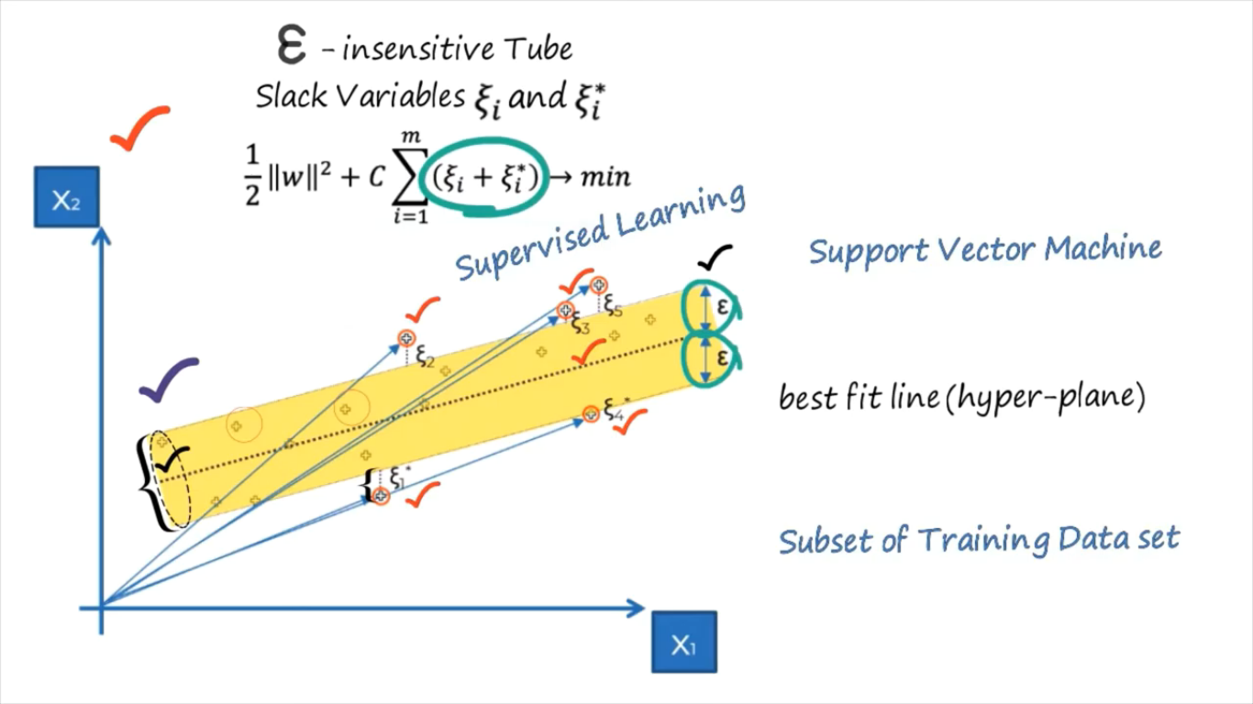

Slide 12
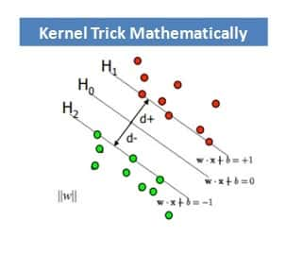
SVM
(HIGH SCHOOL CONCEPT)
Distance of a point〖(x〗_0,y_0) to a line: Ax+By+c = 0 is: |Ax_0 + By_0 +c|/sqrt(A²+B²),
The distance between H0 and H1 is then: |w•x+b|/||w||=1/||w||, so The total distance between H1 and H2 is thus: 2/||w||

Slide 13
Introduction to Logistic Regression
By:Vandana Kate

Slide 15
Logistic regression
Logistic regression is a classification algorithm used to assign observations to a discrete set of classes.
Some of the examples of classification problems are-
Email spam or not spam,
Online transactions Fraud or not Fraud,
Tumor Malignant or Benign.
It is a predictive analysis algorithm and based on the concept of probability
Logistic regression transforms its output using the logistic sigmoid function to return a probability value.

Slide 16
What are the types of logistic regression
Binary (eg. Tumor Malignant or Benign)
Multi-linear functions Class (eg. Cats, dogs or Sheep's)

Slide 17
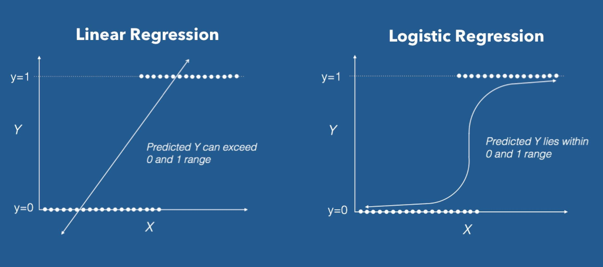

Slide 18

How to restrict value between 0 and 1
Logistic Regression uses activation function called as the ‘Sigmoid function’ or also known as the ‘logistic function’ instead of a linear function.
The hypothesis of logistic regression tends it to limit the cost function between 0 and 1.
Logistic regression hypothesis expectation

Slide 19
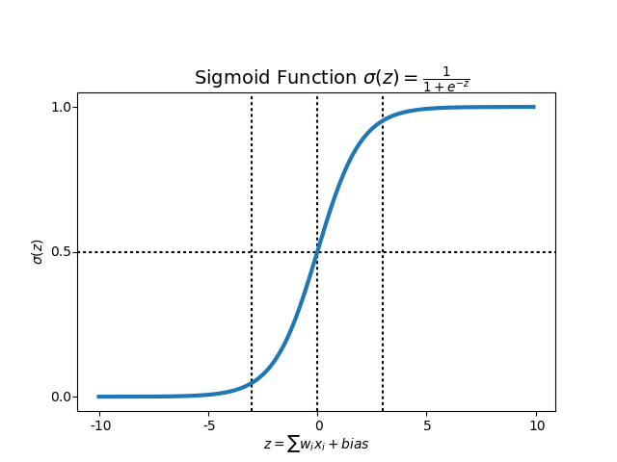
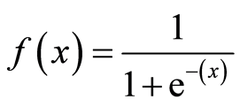
What is the Sigmoid Function?
In order to map predicted values to probabilities, we use the Sigmoid function. The function maps any real value into another value between 0 and 1.
In machine learning, we use sigmoid to map predictions to probabilities.

Slide 20

Cost Function
We learnt about the cost function J(θ) in the Linear regression, the cost function represents optimization objective i.e. we create a cost function and minimize it so that we can develop an accurate model with minimum error.
The Cost function of Linear regression

Slide 21
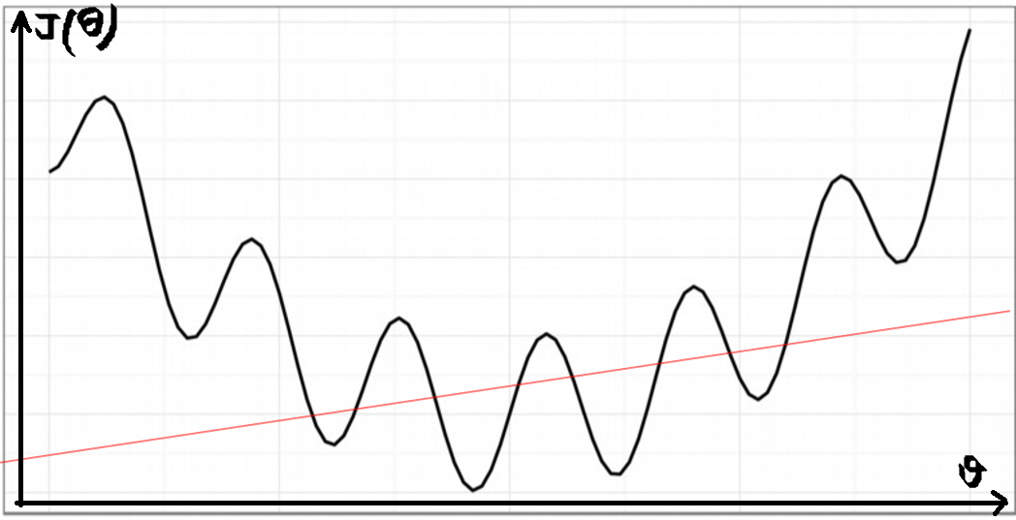
What if we use MSE as Cost Function in Logistic Regression
If we try to use the cost function of the linear regression in ‘Logistic Regression’ then it would be of no use as it would end up being a non-convex function with many local minimums, in which it would be very difficult to minimize the cost value and find the global minimum.

Slide 22
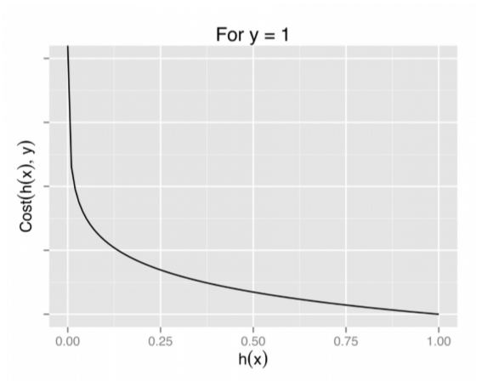
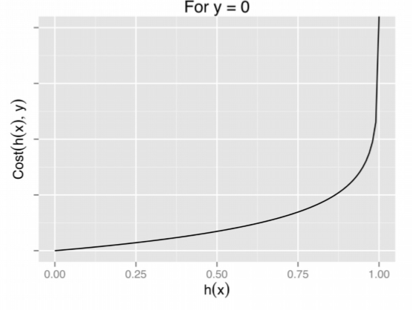
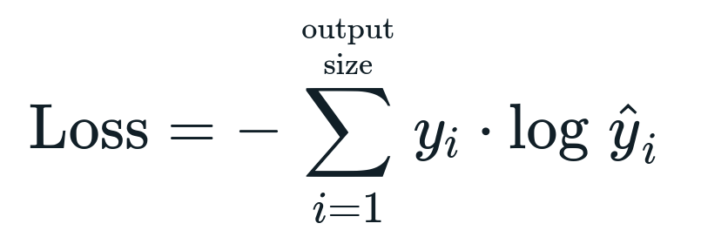

Slide 23
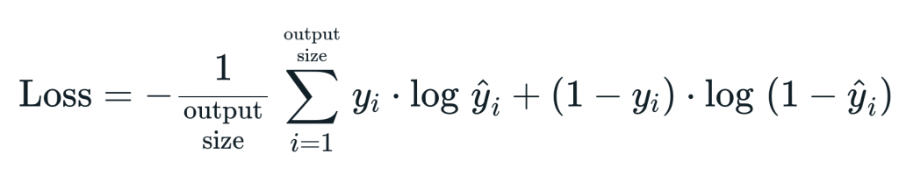
CROSS ENTROPY ERROR

